Slide 1
Stress Management

Slide 2
INTRODUCTION
In the modern society, stress became one of the most
important risk factors, being related to multiple aspects of our adaptive functioning with impact on health status, social role, quality of life, life satisfaction and wellbeing.(1) Stress response is closely related to individual reactions towards environmental changes, perceived as threats and demanding appropriate coping response.(2,3) Measuring perceived stress level and assessing the relation with various personal characteristics became very important and useful for medical, public health, and social interventions.

Slide 3
ABOUT STRESS
The nature of work is changing at whirlwind speed.
Cut throat competition, work pressures, deadlines, and meetings.
The societal set up is changing.
Stress is the reaction of our body to the demands of the life.
There is no definition of stress that everyone agrees on.
The factors may vary.
A person shows symptoms if he is suffering from stress.
A highly subjective phenomenon that it defies definition.

Slide 4
Stress
A condition or circumstance (not always adverse), which can disturb the normal physical and mental health of an individual.
In medical parlance 'stress' is defined as a perturbation of the body's homeostasis. . This demand on mind-body occurs when it tries to cope with incessant changes in life.
Extreme stress conditions, psychologists say, are detrimental to human health but in moderation stress is normal and, in many cases, proves useful.
Stress, nonetheless, is synonymous with negative conditions

Slide 5
Causes of stress
Today, with the rapid diversification of human activity, we come face to face with numerous causes of stress and the symptoms of stress and depression.
Relationship demands
Physical as well as mental health problems
Pressure at workplaces
Traffic snarls
Meeting deadlines
Growing-up tensions
Not having enough work, activities or change in your life
Times of uncertainty

Slide 6
THE DYNAMICS OF STRESS
"Nothing gives one person so much advantage over another as to remain always cool and unruffled under all circumstances.“
—Thomas Jefferson
In a challenging situation the brain prepares the body for defensive action—the fight or flight response by releasing stress hormones, namely, cortisone and adrenaline. These hormones raise the blood pressure and the body prepares to react to the situation. With a concrete defensive action (fight response) the stress hormones in the blood get used up, entailing reduced stress effects and symptoms of anxiety.

Slide 7
When we fail to counter a stress situation (flight response) the hormones and chemicals remain unreleased in the blood stream for a long period of time. It results in stress related physical symptoms such as tense muscles, unfocused anxiety, dizziness and rapid heartbeats. We all encounter various stressors (causes of stress) in everyday life, which can accumulate, if not releasedSubsequently, it compels the mind and body to be in an almost constant alarm-state in preparation to fight or flee. This state of accumulated stress can increase the risk of both acute and chronic psychosomatic illnesses and weaken the immune system of the human body.

Slide 8
Symptoms
Stress can cause headaches, irritable bowel syndrome, eating disorder, allergies, insomnia, backaches, frequent cold and fatigue to diseases such as hypertension, asthma, diabetes, heart ailments and even cancer.
In fact, Sanjay Chugh, a leading Indian psychologist, says that 70 per cent to 90 per cent of adults visit primary care physicians for stress-related problems. Scary enough. But where do we err?

Slide 9
How to deal with stress
Learning to understand and manage stress can prevent the counter effects of stress.
Methods of coping with stress are aplenty. The most significant or sensible way out is :
A change in lifestyle.
Relaxation techniques such as meditation, physical exercises, listening to soothing music, deep breathing,
Various natural and alternative methods, personal growth techniques, visualization and massage are some of the most effective of the known non-invasive stress busters.

Slide 10
STRESS CAN BE POSITIVE
The words 'positive' and 'stress' may not often go together. But, there are innumerable instances of athletes rising to the challenge of stress and achieving the unachievable.
Scientists stressing themselves out over a point to bring into light the most unthinkable secrets of the phenomenal world.
Likewise a painter, a composer or a writer producing the best paintings, the most lilting of tunes or the most appealing piece of writing by pushing themselves to the limit.
Psychologists second the opinion that some 'stress' situations can actually boost our inner potential and can be creatively helpful.
Sudha Chandran, an Indian danseus, lost both of her legs in an accident. But, the physical and social inadequacies gave her more impetus to carry on with her dance performances with the help of prosthetic legs rather than deter her spirits.

Slide 11
Experts tell us that stress, in moderate doses, are necessary in our life. Stress responses are one of our body's best defense systems against outer and inner dangers.
In a risky situation (in case of accidents or a sudden attack on life et al), body releases stress hormones that instantly make us more alert and our senses become more focused.
In a risky situation (in case of accidents or a sudden attack on life et al), body releases stress hormones that instantly make us more alert and our senses become more focused.
Research suggests that stress can actually increase our performance. Instead of wilting under stress, one can use it as an impetus to achieve success.
Stress can stimulate one's faculties to delve deep into and discover one's true potential. Under stress the brain is emotionally and biochemically stimulated to sharpen its performance.
If handled positively stress can induce people to discover their inherent talents.
Stress is, perhaps, necessary to occasionally clear cobwebs from our thinking. If approached positively, stress can help us evolve as a person by letting go of unwanted thoughts and principle in our life.

Slide 12
EFFECTS OF STRESS
Stress is difficult for scientists to define because it is a highly subjective phenomenon that differs for each of us.
Things that are distressful for some individuals can be pleasurable for others. We also respond to stress differently. Some people blush, some eat more while others grow pale or eat less.
There are numerous physical as well as emotional responses as illustrated by the following list of some common signs and symptoms of stress.

Slide 13
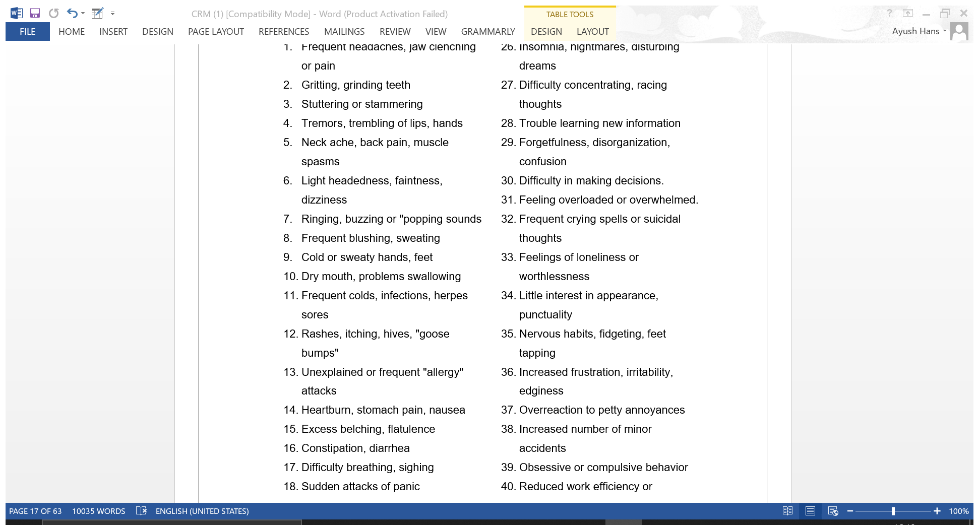

Slide 14
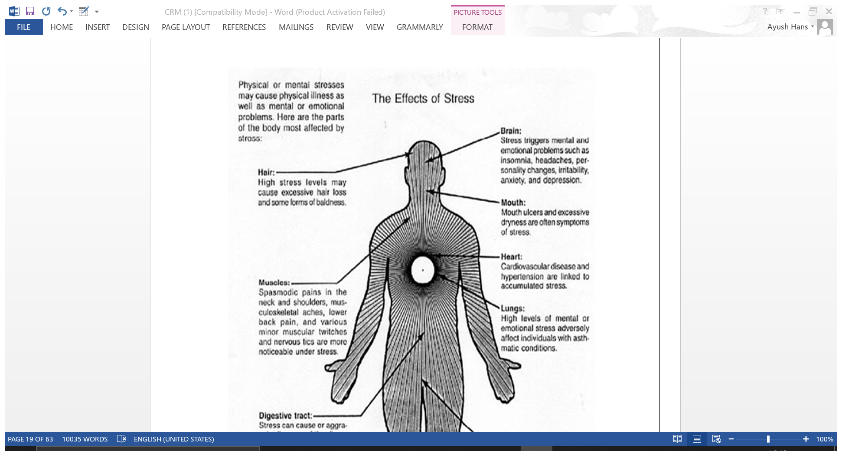
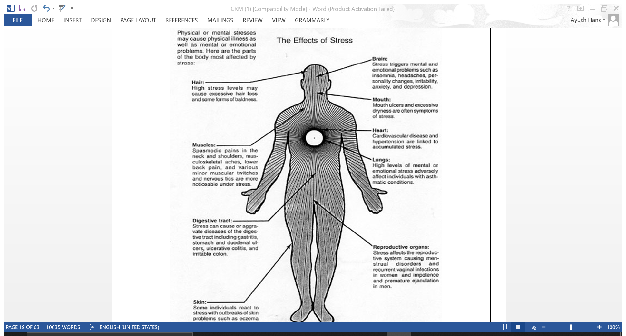

Slide 15
SOURCES OF STRESS
Various sources of stress as identified by Cooper are broadly divided into six categories:
The job itself: Working environment, hours worked, workload and keeping up with technology.
Role in organization: role conflict, role ambiguity, particularly lack of clarity and responsibility.
Relationships at work: interpersonal relationships with peers, superiors and subordinates.
Career Development: Job insecurity, redundancy, skill obsolescence.
Organization structure and climate.
Home-work interference.

Slide 16
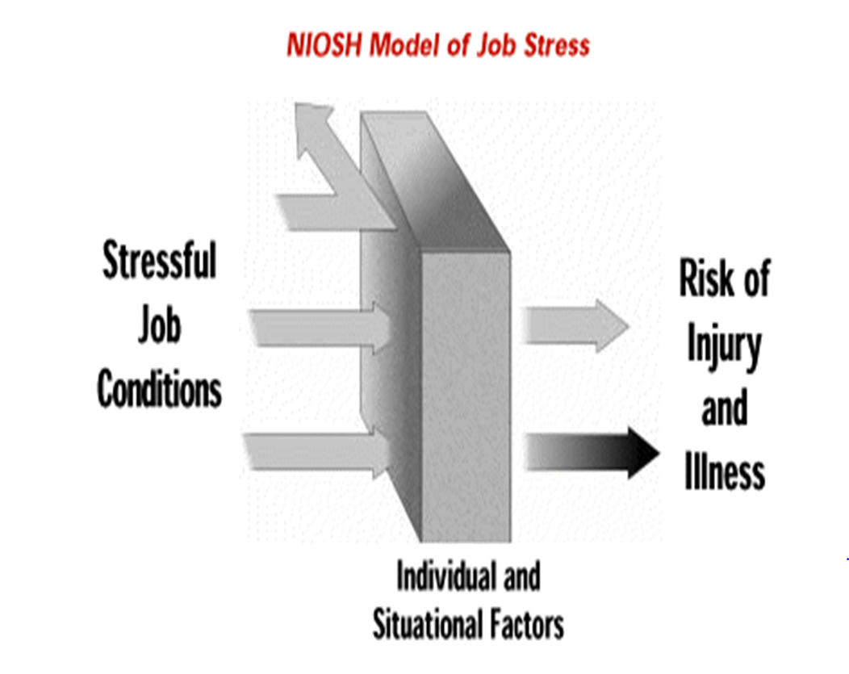

Slide 17
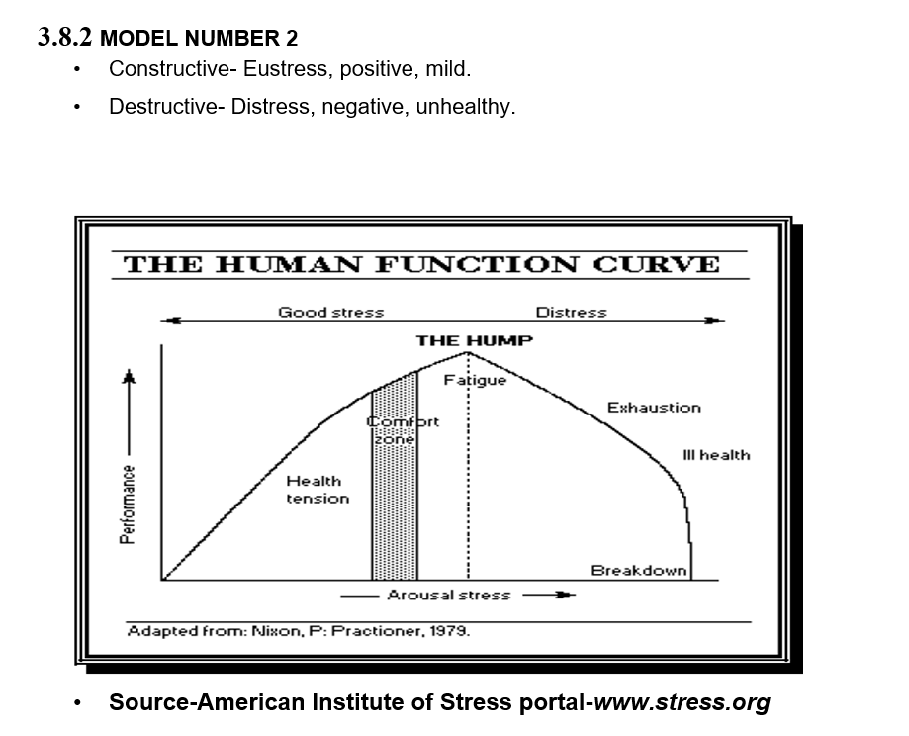

Slide 18
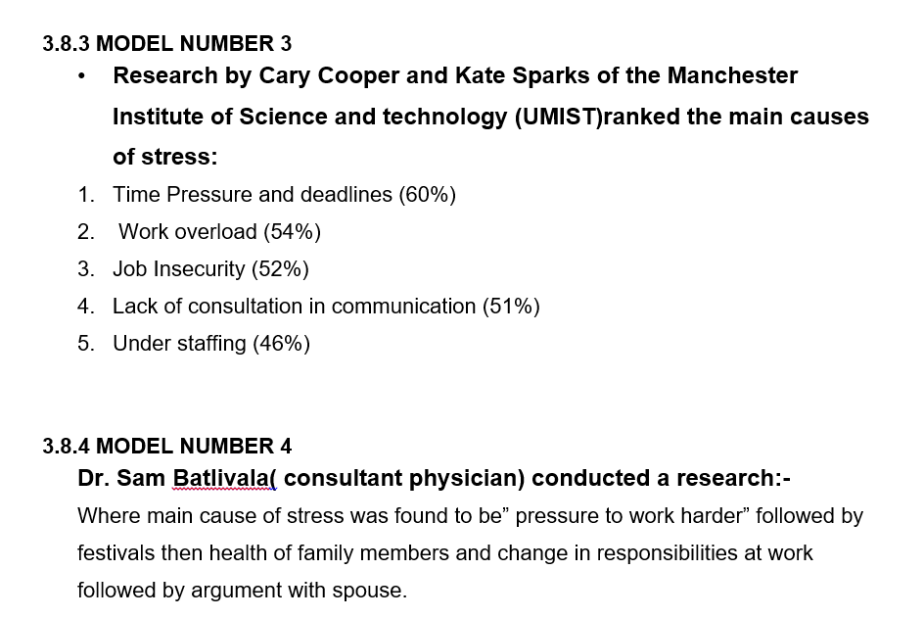

Slide 19
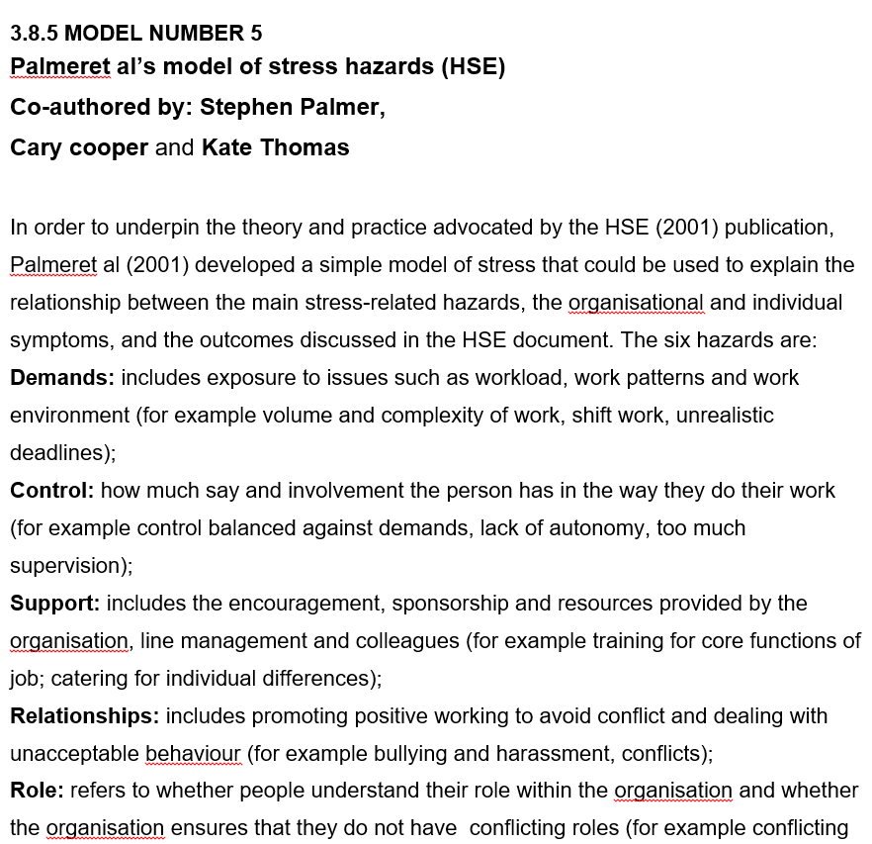

Slide 20
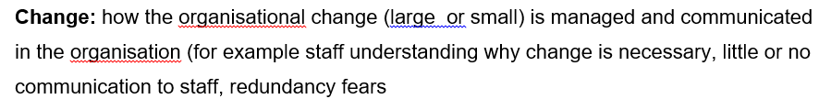

Slide 21
